Slide 1
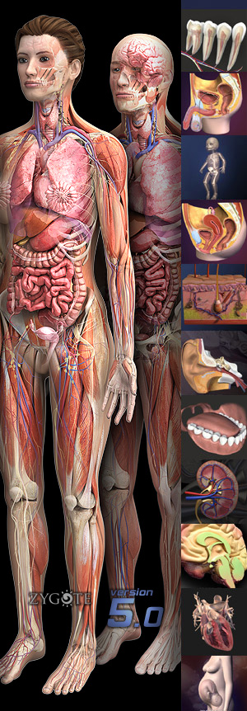
UNIT 1 - The Human Body: An Orientation
Learning Goal:
I can evaluate the structural organization of the body, homeostasis & homeostatic control mechanisms.
I will be able to:
Describe the structural organization of the body from microscopic to macroscopic realms.
Describe homeostasis & homeostatic control mechanisms.
Read, understand & use anatomical direction & body orientation terminology.
Demonstrate understanding of dissection planes by performing a physical dissection.

Slide 2
Unit 1 Latin roots
Ana- = up/upward
-tomy = cut/ incision
Phys- = movement/function
-ology = the study of
Homo- = same
-stasis = condition of standing
Micro- = small
Macro- = large
Cyto- = cell
Hist- = tissue
Path- = disease
Ceph(al)- = head/ brain
Dorsi/o- = back
Dist- = far away
Prox(i)- = closer to
Trans- = across
Para- = next to
Pleur(a)- = lungs
Peri- = around
Cardia/o- = heart
Dia- = across/through
Media- = middle
Viscera- = internal organ
Chrondri/o- = cartilage
Hypo- = underneath
Epi- = on top of/outside of
-gastric = stomach
Radio- = energy/radiation
-graphy = picture/image
Ultra- = an abundance of

Slide 3
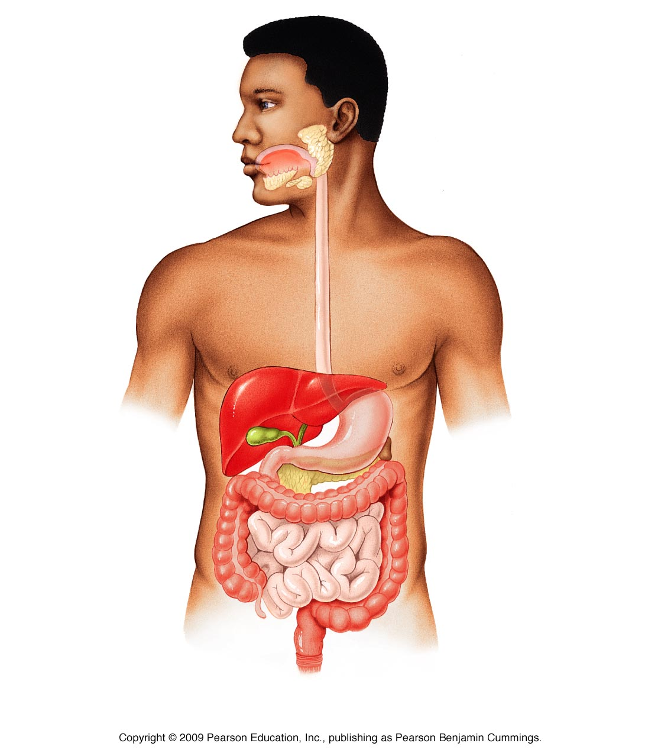
Unit 1, Pt. 1
Introduction to the Human Body

Slide 4
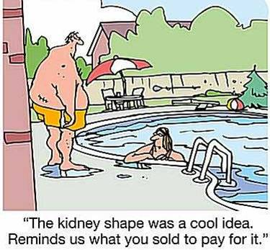
The Human Body—An Orientation
Anatomy - Greek for “a cutting open”
Study of the structure & shape of the body & its parts
Physiology
Study of how the body & its parts work or function

Slide 5
Anatomy—Levels of Study
Gross anatomy
Large structures
Easily observable
Includes
Organ
Organ systems
Regional anatomy
Particular area (i.e, head, leg)
Systemic anatomy
Organ/body system (i.e., nervous system)
Organism level of structural organization

Slide 6
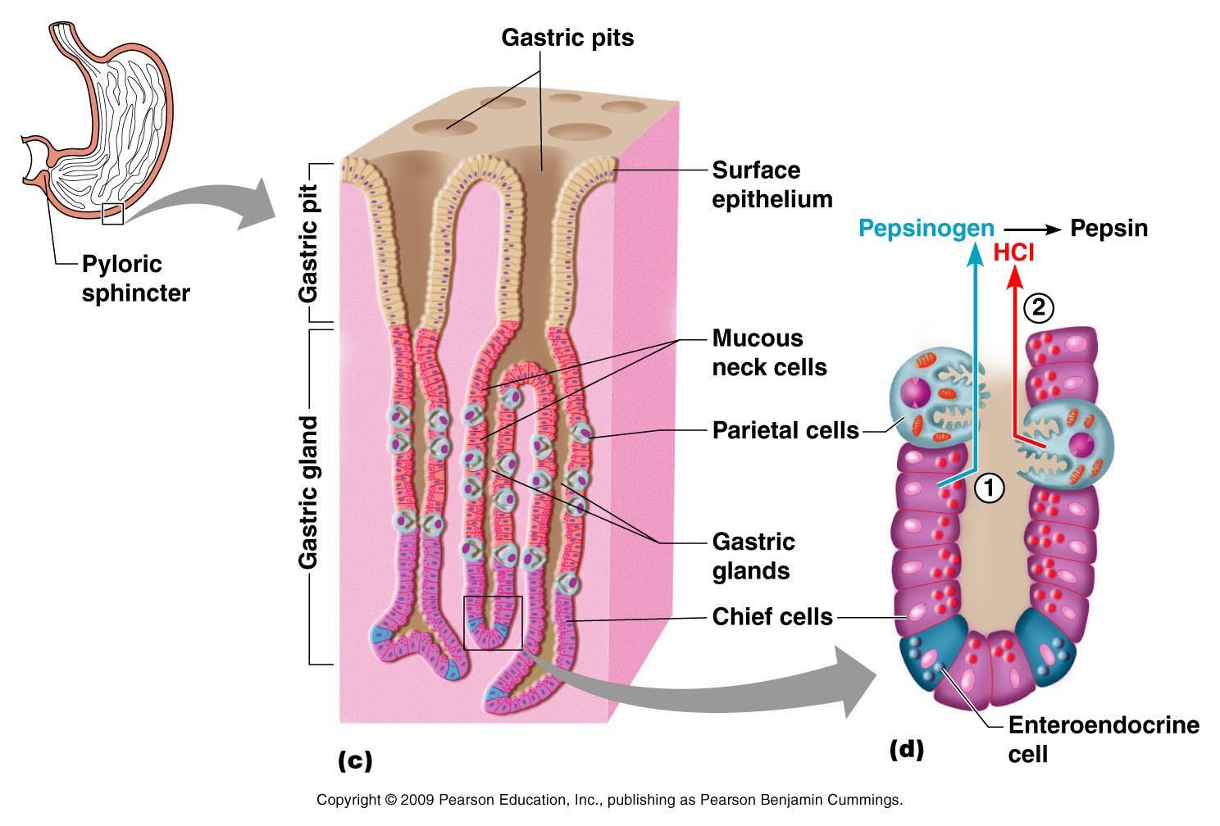
Anatomy—Levels of Study
Microscopic Anatomy
Very small structures
Can only be viewed with a microscope
Includes
Chemical (i.e, microbiology)
Cellular (Cytology)
Tissue (Histology) levels of structural organization

Slide 7
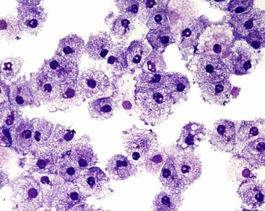
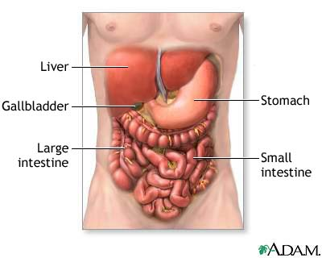
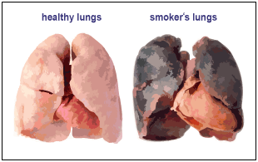
Physiology – Areas of Study
Physiology
Cell Physiology – functions of cells
Special Physiology – specific organs
Systemic Physiology – specific organ systems
Pathological Physiology – effects of disease on organ or system functions

Slide 8
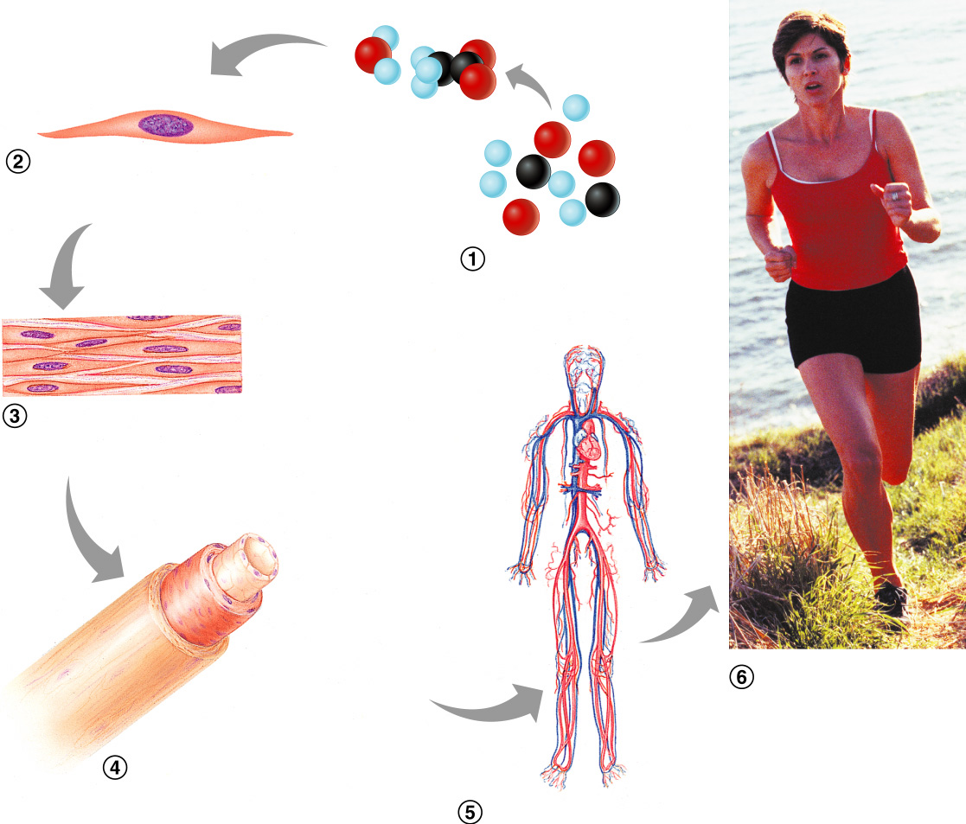
Levels of Structural Organization
Smooth muscle cell
Molecules
Cellular level Cells are made up of molecules
Atoms
Chemical level Atoms combine to form molecules
Smooth muscle tissue
Tissue level Tissues consist of similar types of cells
Epithelial tissue
Smooth muscle tissue
Blood vessel (organ)
Cardio- vascular system
Organismal level Human organisms are made up of many organ systems
Connective tissue
Organ level Organs are made up of different types of tissues
Organ system level Organ systems consist of different organs that work together closely

Slide 9
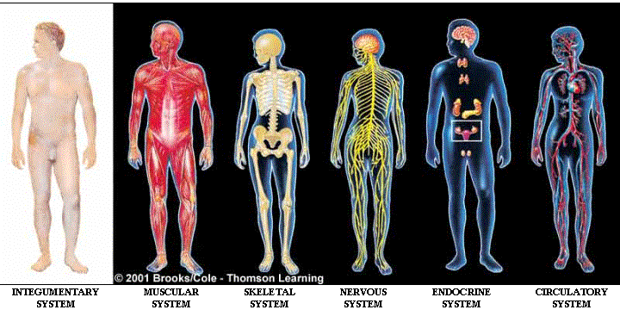
Overview of Body Organ Systems

Slide 10
The 11 Body Systems
Integumentary
Skeletal
Muscular
Nervous
Endocrine
Cardiovascular (Circulatory)
Lymphatic/Immune
Respiratory
Digestive
Urinary (Excretory)
Reproductive

Slide 11
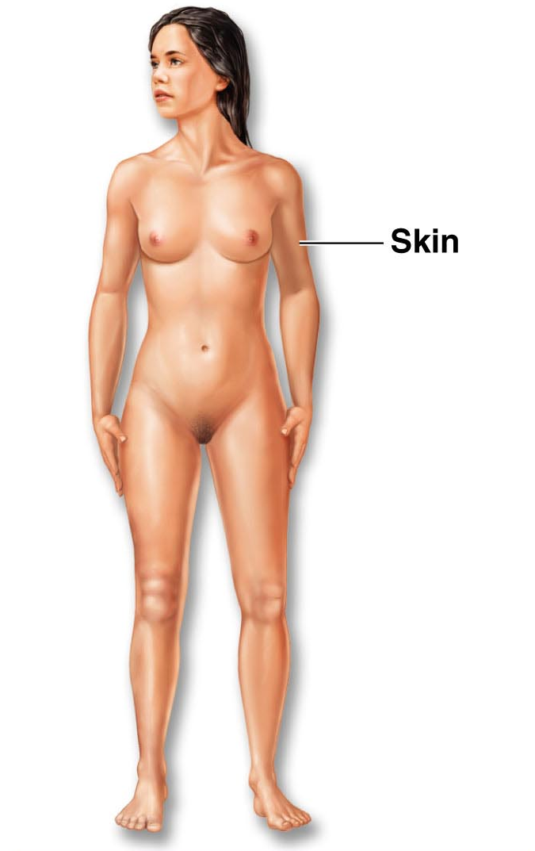
Organ/body System Overview
Integumentary
Functions:
Forms the external body covering
Protects deeper tissue from injury
Helps regulate body temperature
Location of cutaneous nerve receptors
Major organs:
Skin
Hair
Nails

Slide 12
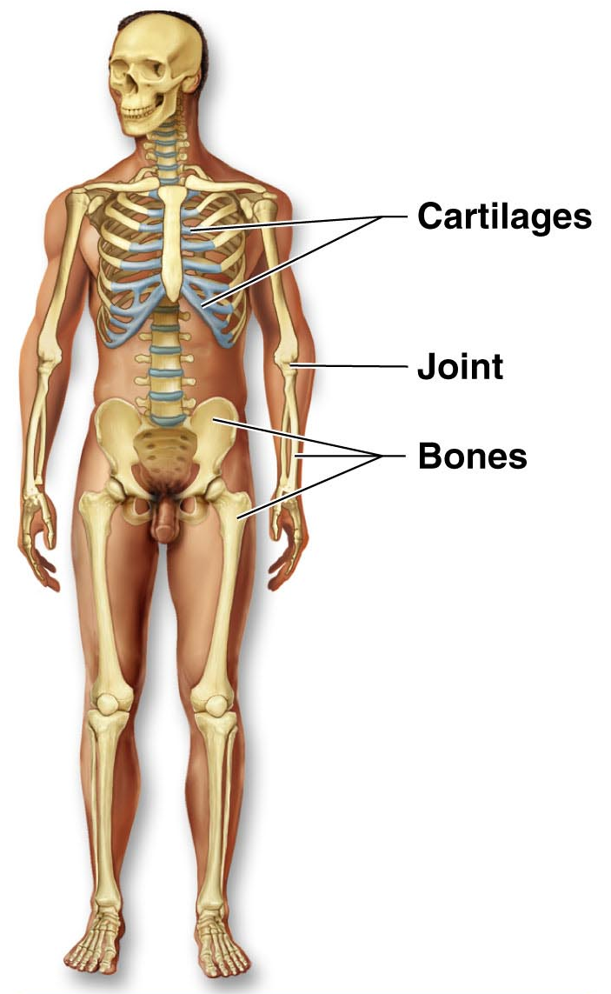
Organ/body System Overview
Skeletal
Functions:
Protects & supports body organs
Provides muscle attachment for movement
Site of blood cell formation
Stores minerals (i.e., Calcium)
Major organs:
Bones
Cartilage
Ligaments

Slide 13
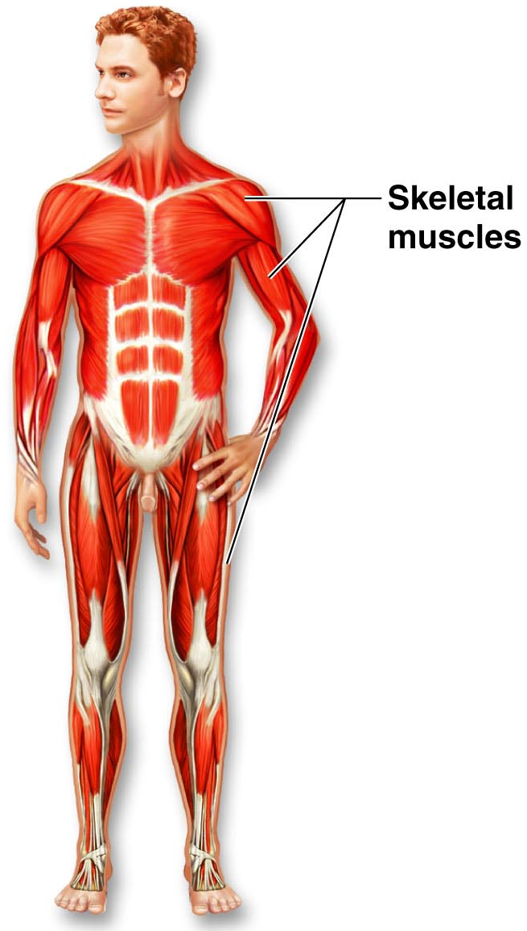
Organ/body System Overview
Muscular
Functions:
Produces movement
Maintains posture
Produces heat
Major organs
Skeletal muscles
Tendons

Slide 14
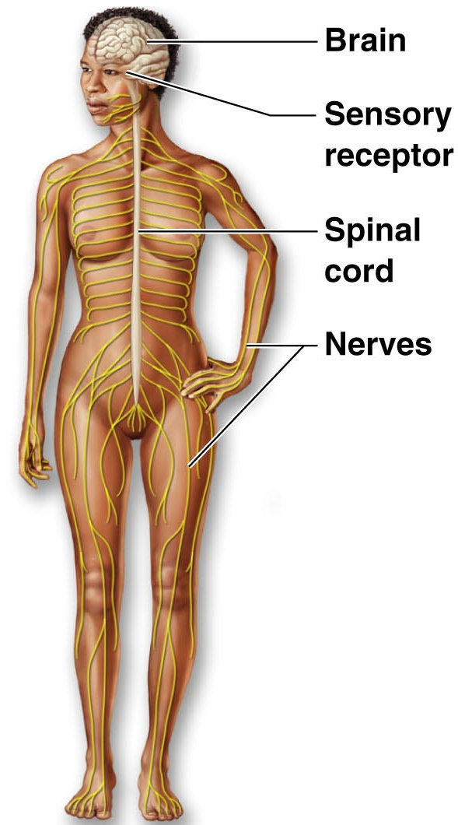
Organ/body System Overview
Nervous
Functions:
Fast-acting control system
Responds to internal & external change
Activates muscles & glands
Major organs:
Brain
Spinal cord
Nerves

Slide 15
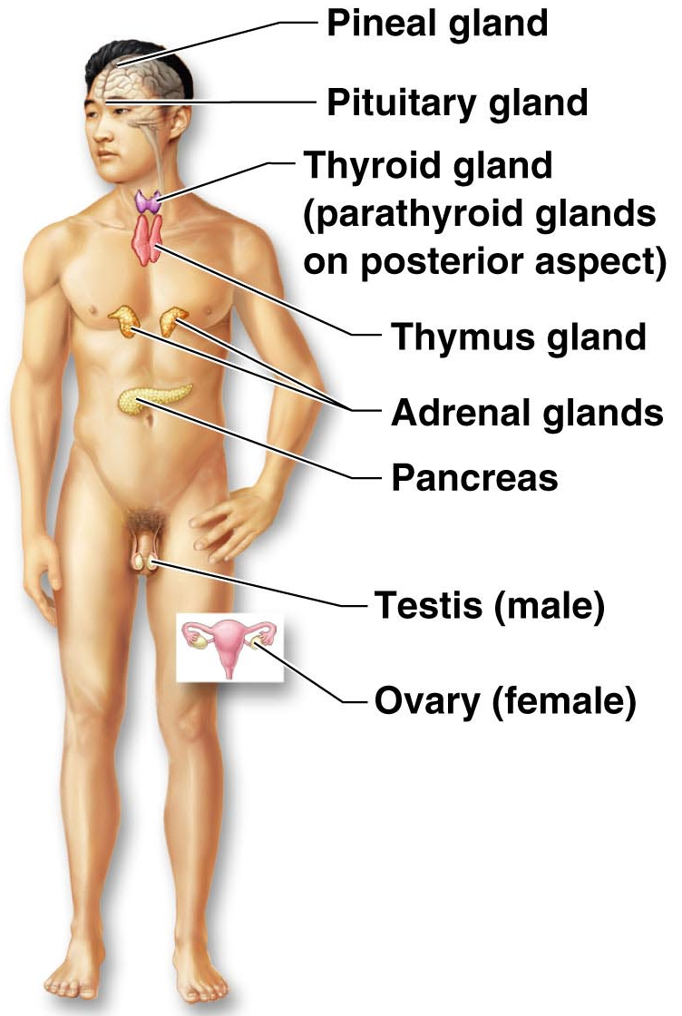
Organ/body System Overview
Endocrine
Functions:
Secretes regulatory hormones for…
Growth
Reproduction
Metabolism
Major organs:
Pineal gland
Pituitary gland
Thyroid gland
Thymus gland
Adrenal glands
Pancreas
Reproductive organs

Slide 16
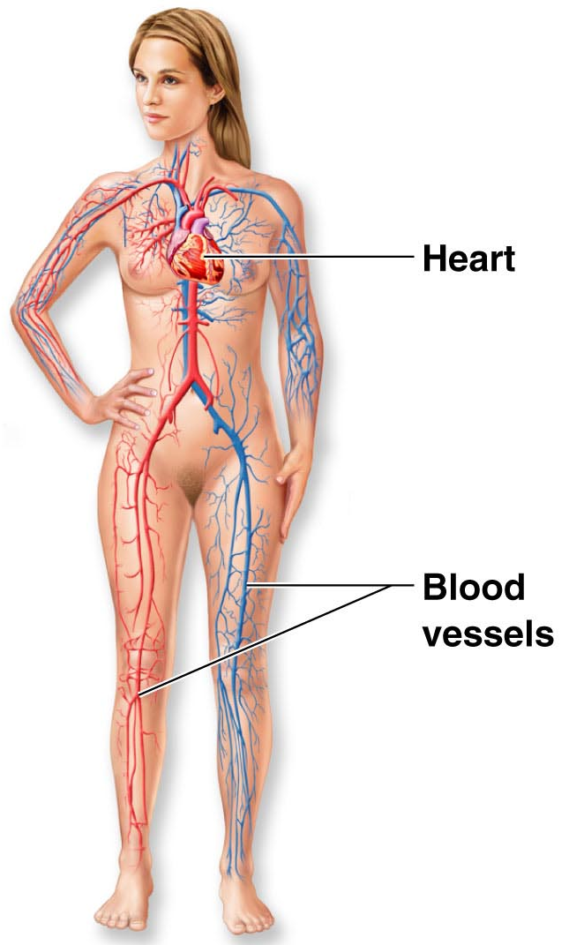
Organ/body System Overview
Cardiovascular
Functions:
Transports materials (i.e., oxygen, carbon dioxide, nutrients, wastes) to & from body cells via blood pumped by heart
Major organs:
Heart
Blood vessels

Slide 17
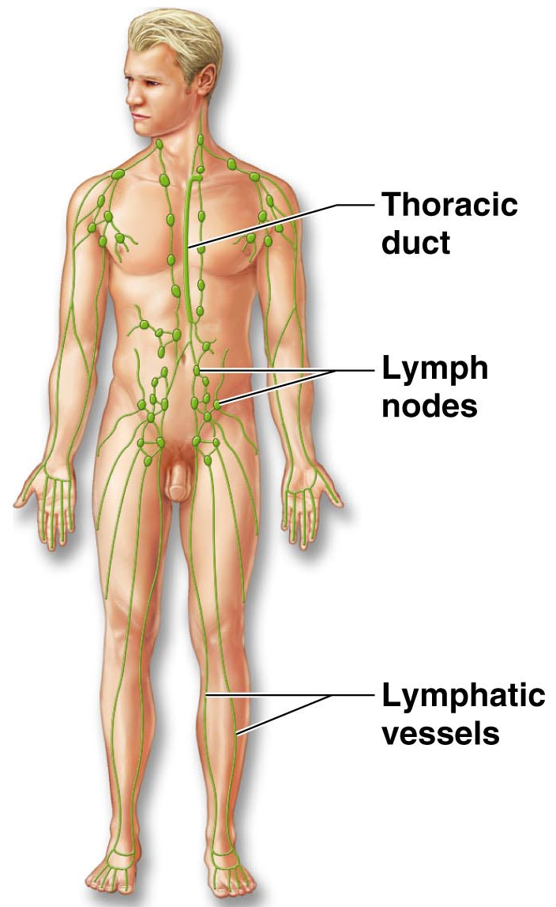
Organ/body System Overview
Lymphatic
Functions:
Returns fluids to blood vessels
Cleanses the blood
Involved in immunity
Major organs:
Thoracic duct
Lymph nodes
Lymphatic vessels

Slide 18
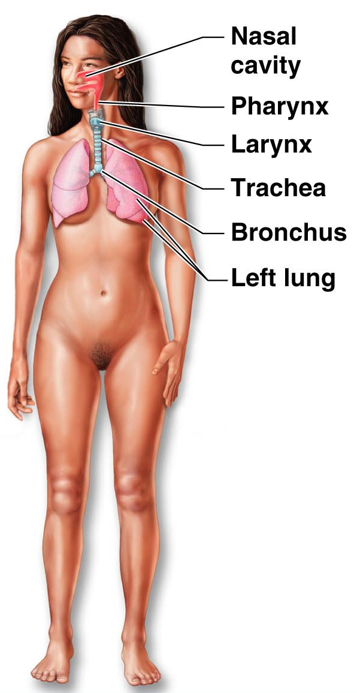
Organ/body System Overview
Respiratory
Functions:
Keeps blood supplied with oxygen
Removes carbon dioxide
Major organs:
Nasal cavity
Pharynx
Larynx
Trachea
Bronchi
Lungs

Slide 19
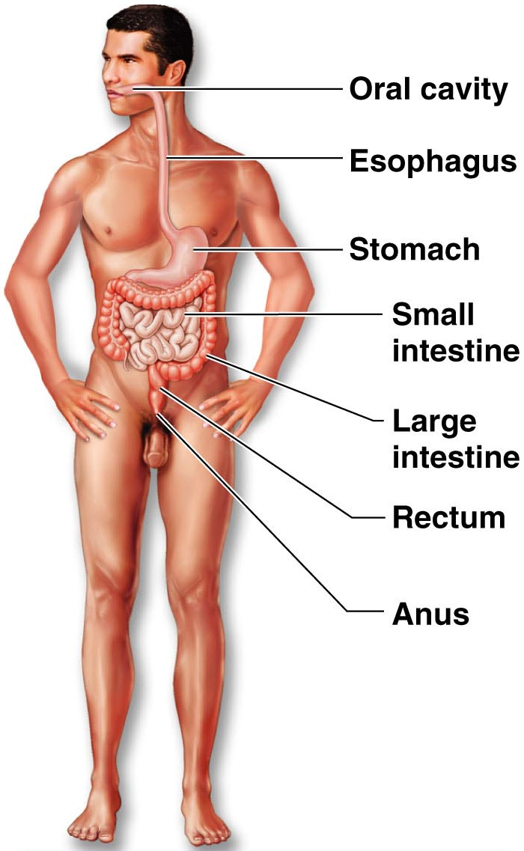
Organ/body System Overview
Digestive
Functions:
Breaks down food
Allows for nutrient absorption into blood
Eliminates indigestible material
Major organs:
Oral cavity
Esophagus
Stomach
Small intestine
Large intestine
Rectum
Anus

Slide 20
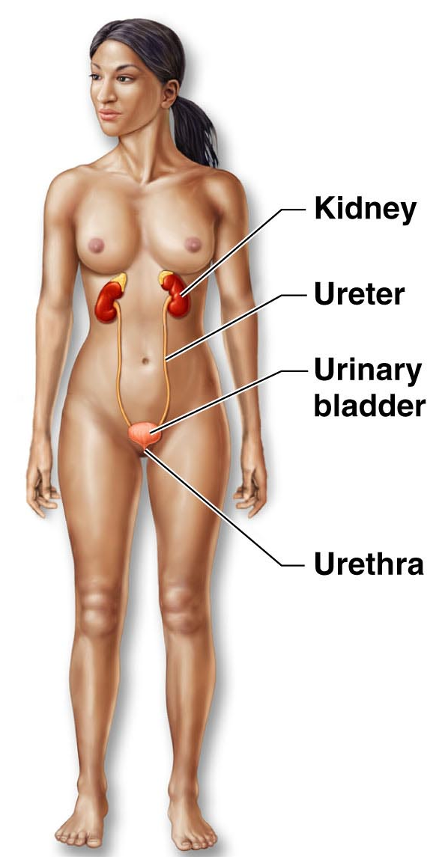
Organ/body System Overview
Urinary
Functions:
Eliminates nitrogenous wastes
Maintains acid-base balance
Regulates water & electrolytes
Major organs:
Kidney
Ureter
Urinary bladder
Urethra

Slide 21
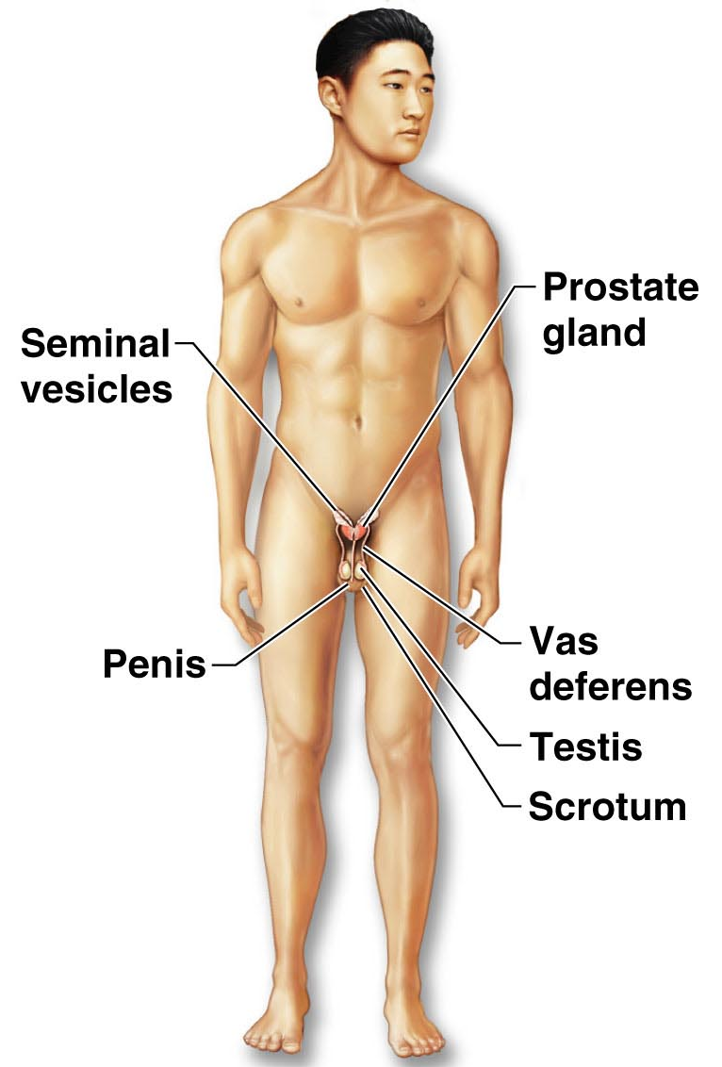
Organ/body System Overview
Reproductive
Functions:
Produces offspring
Major organs:
Male
Prostate gland
Seminal vesicles
Penis
Vas deferens
Testis
Scrotum

Slide 22
Organ/body System Overview
Reproductive
Functions:
Produces offspring
Major organs:
Female
Mammary glands
Uterine (fallopian) tubes
Ovary
Uterus
Vagina

